Slide 1

First Quarter 2012
Capital Markets Outlook
Volatility Trumps Returns
The information herein reflects prevailing market conditions and our judgments, which are subject to change, as of the date of this document. In preparing this document, we have relied upon and assumed, without independent verification, the accuracy and completeness of all information available from public sources. Opinions and estimates may be changed without notice and involve a number of assumptions that may not prove valid. There is no guarantee that any forecasts or opinions in this material will be realized. Information should not be construed as investment advice.
Investment Products Offered:
Are Not FDIC Insured
May Lose Value
Are Not Bank Guaranteed
Notes:
Thank you for joining me today for a review of our capital markets outlook.
Let’s start with a recap of recent performance…

Slide 2
Bank of America Corporation (“Bank of America”) is a financial holding company that, through its subsidiaries and affiliated companies, provides banking and investment products and other financial services .
Merrill Lynch, Pierce, Fenner & Smith Incorporated is a wholly-owned subsidiary of Bank of America Corporation, and a registered broker-dealer and member of FINRA and SIPC.
Investment products provided by Merrill Lynch, Pierce, Fenner & Smith, Incorporated:
The views and opinions expressed in this presentation are not necessarily those of Bank of America Corporation; Merrill Lynch, Pierce, Fenner & Smith Incorporated; or any affiliates.
Nothing discussed or suggested in these materials should be construed as permission to supersede or circumvent any Bank of America, Merrill Lynch, Pierce, Fenner & Smith Incorporated policies, procedures, rules, and guidelines.
Merrill Lynch, Pierce, Fenner & Smith Incorporated are not tax or legal advisors. Clients should consult a personal tax or legal advisor prior to making any tax or legal related investment decisions.
Are Not FDIC Insured | Are Not Bank Guaranteed | May Lose Value
Notes:
1
Review Slide with participants.

Slide 3
A Turbulent Year for Risk Assets
Returns in USD
Annualized Returns
Since March 2009
2011 Returns
4Q 2011 Returns
US Small Cap
CATHY WILL PROVIDE DATA
Through 12/31/11
US Large Cap
Equities
EAFE*
Emerging Markets
Global High Yield
Credit
EM Debt
Global Corp
Municipals
Gov’t
Bonds
US Gov’t
Japan Gov’t
Euro Gov’t
Commodities
Alternatives
TIPs
Global REITs
Past performance does not guarantee future results.
As of December 31, 2011
*EAFE = Europe, Australasia, Far East
Global High Yield, Global Corp, Japan Gov’t and Euro Gov’t in hedged USD terms. All other non-US returns in unhedged USD terms.
Individuals cannot invest directly in an index. Please see the end of the presentation for index definitions.
Source: Barclays Capital, DJ-UBS, FactSet, FTSE, MSCI, Standard & Poor’s and AllianceBernstein
Notes:
2
2
Stocks endured an extraordinarily volatile year in 2011 and finished the year down in Europe and Asia, though US large cap markets saw modest positive returns. Even though stocks have produced strong returns from the market bottom reached in March of 2009, markets continue to struggle amidst many sources of anxiety.
In fixed income, safe haven government bonds around the world benefited from the bouts of risk aversion in the market during the year. Credit posted positive returns for the year, as emerging market debt and global high yield bonds were helped by a strong fourth quarter.
Alternative assets such as TIPS, REITs and commodities rose in the fourth quarter, but only TIPS generated strong calendar year returns.

Slide 4
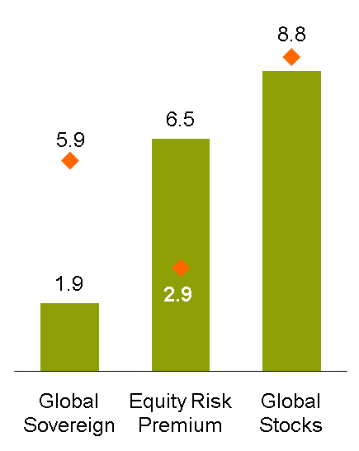
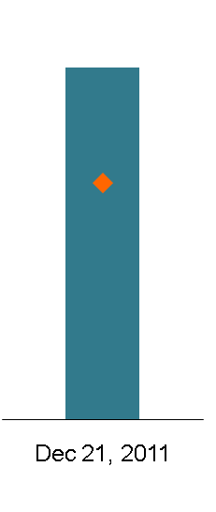
Equities Attractive, but Volatility Overwhelms Valuations
Long-Term
Expected Return (%)
Near-Term
Expected Global Equity Volatility (%)
Asset Allocation
Our View of Equity Allocation
Long-Term 60/40 Investors
Long-term Average
70
21.7
8.4
14.6
60
Normal
Equity Allocation (%)
Global Stock Index
50
40
Historical analysis and current forecasts do not guarantee future results.
Data do not represent past performance and are not a promise of actual results or range of future results.
Global sovereign bonds are represented by global, developed, sovereign, seven-year constant-maturity nominal bonds; global stocks by a universe similar to MSCI World. Both are reported in and hedged into US dollars.
*Equity here refers to 70% US equity (MSCI USA) and 30% international equity (25% MSCI EAFE, 5% MSCI EM). **Represented by the MSCI All Country World Index.
Individuals cannot invest directly in an index. Please see the end of the presentation for index definitions.
Source: MSCI and AllianceBernstein
Notes:
Thursday, January 12, 2012
3
Looking forward, you see that the annualized expected returns on global sovereign bonds, depicted by the green bar, are well below their long-term average, represented by the orange diamond. This reflects the premium prices currently commanded by these so-called “safe” assets.
Stocks, meanwhile, offer expected returns that are about in line with their historical average. That puts the equity risk premium for investing in stocks over bonds at more than double its long-term average.
While this means that stocks should significantly outperform high-grade sovereign bonds over the next ten years, we are cautious in the near term. Market volatility remains very high and is likely to persist. This will weigh on the returns of risk assets over the coming year. As of December 2011, our Dynamic Asset Allocation team accordingly believes that equities should be held at levels about ten percentage points below the strategic target for a 60/40 stock/bond portfolio.

Slide 5
Risk Aversion Remains Highly Elevated
UPDATED
Through 12/31/11
Received Data From
Guoan Du
Risk Aversion
Global Risk Aversion Indicator*
Financial Crisis
Russian Default
and LTCM
9/11
Iraq
Today
Risk Appetite
Historical analysis does not guarantee future results.
Through January 4, 2012
*Measures the degree of risk aversion by combining the implied volatility of equities, currencies, commodities and bonds with credit spreads and mutual fund flows.
Source: Bloomberg, Investment Company Institute (ICI) and AllianceBernstein
Notes:
4
Market volatility is being driven largely by fear. Since the Great Financial Crisis in 2008, investors have reacted strongly to news suggesting systemic threats to economies.
This chart depicts AllianceBernstein’s proprietary Global Risk Aversion Indicator, which uses volatilities and spreads globally across asset classes to measure the amount of risk appetite in the marketplace. The zero line represents a “normal” level of risk appetite. When the line is negative it suggests that people are willing to reach out for more risk. When the line is above the zero line, it shows that people are risk averse, which is simply another way of saying they seek safety.
The history of risk aversion shown here shows that fear spiked in 1998 (the Russian debt default and the collapse of Long Term Capital Management, a hedge fund run in part by Nobel-prize winning economists), on 9/11, and during the invasion of Iraq when the world feared the use of weapons of mass destruction. After years of complacency, we saw a historic period of market trauma in 2008 when people feared the world might slide into the next great depression. You can see that spikes of fear have been common since then, with recent concerns about Europe driving anxiety to the second highest level seen in nearly twenty years.

Slide 6
Uncertainties Drive Market Volatility
United States
China
Future tax policy
Deficit reduction
Health care
Growth
Housing
Credit
Brazil & Argentina
Thailand & Japan
Inflation vs. growth
Natural disaster
Arab World
North Korea & Iran
Political transition
Nuclear weapons
Russia
Europe
Political uncertainty
Sovereign debt
Integration/separation
Inflation/deflation
As of December 30, 2011
Source: AllianceBernstein
Notes:
There is no shortage of things to worry about, of course.
In the United States, a bitterly divided Washington cannot agree on critical issues of taxation, health care, and fiscal policy. We may not see material progress toward clarity until after the upcoming national elections.
To the south, Latin American countries such as Brazil and Argentina are attempting to balance efforts to contain inflation and a desire to rekindle economic growth.
The Arab world remains embroiled in political transition, a process which is likely to take a long time, adding uncertainty to the world’s supply of oil.
Russia, an important military power and supplier of energy to Europe, is itself in the midst of a political turmoil as the populace calls for reforms and Putin seeks another term as President.
China, an important engine of the global economy’s growth, is grappling with housing, inflation, and growth, with some fearing that policy errors may disrupt the Chinese economy and weaken global demand for commodities.
We’ve just lived through a year of formidable natural disasters – one of the most expensive years on record at nearly $350 billion or half a percent of global GDP – which included Japan’s earthquake in March and more recently flooding in Thailand that posed enormous challenges for global supply chains.
The death of Kim Jong-il, dictator of North Korea for almost twenty years (1994 to 2011), has created an uncertain power vacuum in a country believed to possess nuclear weapons, even as Iran’s Mamoud Ahmadinejad appears to be developing its own nuclear weapons under the guise of commercial nuclear power.
But the greatest cause of concern to global markets this year has been and is the ongoing sovereign debt crisis in the Euro Area.

Slide 7
Eurozone Bond Markets Reflect a Crisis of Confidence
35
Sovereign 10-Year Bond Yields
Greece
14
Portugal
Italy
Spain
Belgium
France
Germany
Past performance and historical analysis do not guarantee future results.
As of November 30, 2011
Source: Haver Analytics
Notes:
Last quarter we stated our belief that the biggest risk posed by the debts of Greece, Ireland, and Portugal was that of contagion – in other words, that failure to effectively deal with the problems of these relatively small countries would cause investor doubts to spread to larger debt markets such as Italy, Spain, and France. In the fourth quarter of 2011, that happened.
This chart shows yields of sovereign bonds of Euro Area countries. In 2010 Greece and Portugal’s yields soared, a reflection that nervous investors wanted higher compensation for owning risk assets. Italy and Spain soon followed, modestly at first, but then worsening as markets questioned the ability and/or wiliness of national and Euro Zone leaders to make necessary reforms.
We do not know what will ultimately happen in the Euro Area, but we do know that the costs of failure are very high. The collapse of the euro would be highly disruptive to all concerned, and hence governments have a powerful incentive to arrive at solutions. The current path is pointing toward a higher degree of fiscal discipline, though the precise means by which governments will be forced to keep their deficits in check is still unclear. The European Central Bank (ECB) has stepped up liquidity to ease the funding concerns of Euro Area banks, and calls continue for enhanced support of sovereign debt through the European Financial Stability Facility (EFSF) and/or the ECB.
As all of this plays out, it is possible that some nations will not be able to adopt the necessary degree of discipline and, as a result, have to leave the Euro Area. This would likely result in an abrupt, sharp economic crisis for the nations concerned. We believe that austerity will be a drag on growth in Europe for some time to come.

Slide 8
Euro Area Sliding into Recession
Euro-Area Composite PMI* and Economic Sentiment
Manufacturing PMI
Data Source: Dec 1st FI Forecast Package
pgs 9 & 10
Standard Deviation†
ESI**
Percent
PMI
Global ex
Euro Area
Euro Area
As of November 30, 2011
*Purchasing Managers Index (PMI): An indicator of the economic health of the manufacturing sector. It is based on five major indicators: new orders, inventory levels, production, supplier deliveries and the employment environment.
**The Economic Sentiment Indicator is a composite of European Central Bank sector confidence indicators.
†Standard Deviation shows how much variation or “dispersion” exists from the average.
Source: Haver Analytics and Markit
Notes:
Indeed, the Euro Area appears to be already sliding into recession. The display on the left shows dramatic declines in the Economic Sentiment Indicator (ESI), a composite of confidence indicators from the European Central Bank, and the Purchasing Managers Index (PMI), which shows financial activity related to purchasing managers’ acquisition of goods and services. The PMI measures the activity of thousands of euro zone companies. Although initial December Euro Area data shows the index rose slightly (not shown in the chart), it remains well below the demarcation line of 50 that divides growth from contraction. France and Germany seem to have been responsible for the overall improvement, with the weaker peripheral countries holding down the overall tally. While the Euro Area is not yet in free fall, policy errors could lead to a longer and deeper downturn.
On the right hand side, you can see that Europe’s economy is decoupling from the global economy. Manufacturing PMI has plummeted in the Euro Area, while it has improved globally and crossed into the expansionary range.

Slide 9
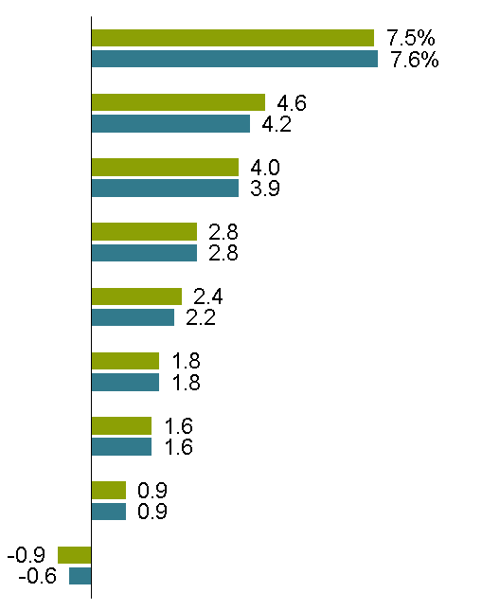
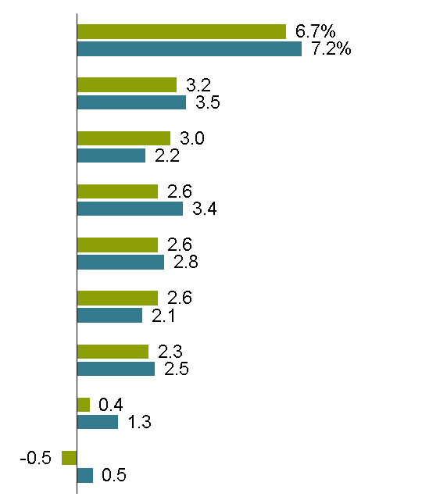
Despite Euro Area Weakness, the Global Economic Recovery Continues
World Economic Growth Forecast
Percent Average Annual Rate
2011
2012
UPDATED
Data Source: Dec 1st FI Forecast Package
Asia ex Japan
Asia ex Japan
EEMEA*
Latin America
Latin America
US
Global
EEMEA*
Canada
Global
US
Canada
Euro Area
AllianceBernstein
Consensus
Japan
UK
UK
Japan
Euro Area
Forecasts are subject to change.
As of January 3, 2012
*Eastern Europe, Middle East and Africa (including Hungary, Poland, Turkey, Russia and South Africa).
Note: Consensus estimates are based on the latest available survey from November 2011.
Source: Consensus Economics and AllianceBernstein
Notes:
Outside of the Euro Area, we expect to see a continuation of real GDP (Gross Domestic Product) growth in 2012. In our view, growth will be lead by Emerging Markets countries, including China, with a strengthening contribution from the United States, which we expect to grow at an above consensus rate of 3 percent. Global growth should come in at about 2.6% in 2012, with the Euro Area contracting by half a percentage point. While the ongoing sovereign debt crisis, declining consumer sentiment, and policy in-action pose risks to the downside for the Euro Area, better global conditions may cushion the impact on exporting Euro Area countries.
A couple of comments on China: While overshadowed by recent events in Europe, markets have remained anxious about the growth rate of the Chinese economy. We believe that policymakers in China are successfully transitioning their economy from excessive, inflationary growth to a soft landing and more sustainable rates of growth. Consistent with this idea, economic data through December has been a bit slower, but not reflective of a hard landing. Indeed, we expect that while exports are expected to play a less important role in economic growth, domestic construction and increased consumer spending should lead to real GDP growth in the 8% range in 2012.
A key aid to Chinese growth in 2012 is a decline in inflation. We talked about this last quarter, and our view that inflation within China, driven in large part by food, had peaked in our opinion and would start to recede. As we have discussed, falling inflation will allow China to cut rates as a means of stimulating further growth. Recently China made its first move in this regard, cutting the reserve requirement ratio, or RRR, by 50 basis points. We expect China to continue to cut rates meaningfully –both the RRR and the central bank’s official lending rate –in 2012. More broadly, this theme of falling inflation allowing for monetary easing is one that we expect to play out in many Asian countries in 2012.
This is important, as China, and the broader Asia ex-Japan region as a whole, is an important consumer of global commodities and, increasingly, an important market for manufactured goods.
From a relative growth perspective however, as we have been talking about, the US economic story is an important one to watch, and one that more and more eyes recently have begun to focus on more intently.

Slide 10
US Economy Defies Pessimism
US Economy Surprises on the Upside
Indicators Point to Growth
Citigroup Economic Surprise Index*
Leading Economic Indicators**
Index
Index
Historical analysis does not guarantee future results.
*Weighted historical standard deviation of data surprises. Data through December 23, 2011.
**Data through November 2011
Source: Citigroup, The Conference Board, Haver Analytics and AllianceBernstein
Notes:
Recent data from the US economy has been stronger than expected. The Citigroup Economic Surprise Index, a measure of data surprises relative to analyst expectations, has turned strongly positive, meaning that actual results have been much better than experts had anticipated. For example, payroll employment in the US has exceeded consensus forecasts over the past two to three months, and in addition has seen several upward revisions totaling 102,000 for the three months of September, October, and November. While these indicators are backward looking, on the right chart we see a signal for future performance, the Leading Economic Indicators (LEI), which are strongly positive. The LEI includes a broad range of economic metrics, including hours worked and orders, and has a strong history of forecasting coming economic conditions.

Slide 11
US Recovery Thus Far Has Been Driven by Exports and Capex*
Exports and Investment Growth
Have Led Latest Recovery…
…but Consumption Is the Largest Component
Contribution to GDP Growth (First 9 Quarters of Recovery)
Consumption & Housing vs. Exports & Investment
Components of 2010 Gross Domestic Product (GDP)
14%
20%
100%
13%
-18%
71%
Personal
Consumption
Private
Investment
US
Gov’t
Exports
Imports
GDP
Sum of Real GDP
Historical analysis does not guarantee future results.
*Capital Expenditure (Capex): Funds used by a company to acquire or upgrade physical assets such as property, industrial buildings or equipment.
**Recessions since 1960
Source: Bureau of Economic Analysis and Haver Analytics
Notes:
We have spoken for some time about the “new mix” of economic activity underlying this US recovery. In the past, consumption and housing were the dominant factors leading US growth following recessions. This time has been different: exports and investment have led the way. The chart on the left shows how these sectors have contributed more to this recovery than they have in past recoveries, and how consumption and housing have lagged compared to past recoveries. This is important, because consumption comprises the largest component of GDP, as seen on the right. We believe that an improvement in consumption and housing is necessary to sustain the US recovery, and we are seeing evidence that conditions in these sectors are improving.

Slide 12
US Exports Continue to Grow Despite Slowdown in Europe
US Real Exports by Quarter: Jan 2000–Sep 2011
US Exports by Destination: 2010
US Exports by Product: 2010
Historical analysis does not guarantee future results.
*Including Italy at 1.1%, Spain 0.8%, Ireland 0.6%, Greece 0.1% and Portugal 0.1%
Source: Bureau of Economic Analysis and AllianceBernstein
Notes:
Let’s start with US exports, which continue to show strength, as you can see on the left hand chart.
While some fear that a slowdown in Europe may harm US exports, in fact the United States has very little export exposure to troubled Eurozone countries. The display in the upper right shows the largest ten US export destinations. The UK and Germany rank 5th and 6th, accounting for less than 4% of US exports each. Not shown are Italy at 1%, Spain at 0.8%, Ireland at 0.7%, and Greece and Portugal, which each account for less than a tenth of one percent of US exports.
The United States ranks with China and Germany as one of the top three manufacturing exporters in the world. The composition of US exports is shown in the display in the lower right, capital equipment, which includes computer equipment, semiconductors and medical equipment, comprising the most important share.

Slide 13
US Capex Rising, Household Balance Sheets Stronger
US Capex vs. Depreciation*
US Household Financial Obligations Ratio**
Capex
Depreciation
Percent
Historical analysis does not guarantee future results.
*Through December 31, 2010 (latest available)
**US household financial obligations as a percent of household income (through 3Q 2011).
Source: Bureau of Labor Statistics, Federal Reserve Board and Haver Analytics
Notes:
Capital investment should also continue to contribute to US growth next year. After dipping below the rate of depreciation during the recession, capital expenditure (capex) in the US is recovering. We believe that companies deferred capital investment in 2008 and 2009 and now have the need, ability, and willingness to spend.
On the right, household deleveraging has improved the condition of US household balance sheets to levels not seen since the early 1990s. While deleveraging has been a drag on the recovery thus far, we are seeing encouraging signs that consumer spending (and consumer sentiment) should remain solid. An improving labor market in 2012 would support this trend.

Slide 14
US Housing Drag Expected to End
Average Rate of
Household Formation
1.3 million
Thousands
Historical analysis does not guarantee future results.
Through December 30, 2011
Source: Haver Analytics, US Census Bureau and AllianceBernstein
Notes:
Turning to the fourth and final recovery factor, the recent recession in the US was caused in large part by a housing bubble and the means by which it was financed. However, while housing construction and related demand plunged in the aftermath, the need for housing has continued to accumulate.
The vertical bars in this display show household formation – the inevitable process of young people moving out of their parents’ homes and into their own. The rate of household formation is volatile and tied to economic conditions, but demographics are stable and the long term average of 1.3 million new households per year is a real and continuing phenomenon. The moving line shows housing starts for single and multifamily homes. This display shows that after 2007, housing starts collapsed and the pace of household formation fell to well below average, even though the US population continued to grow. This situation isn’t sustainable – household formation should rise to higher levels over time. The pent-up demand for housing is building, and recent data shows that building permits are up. While the mix of multifamily housing versus single family housing is tilted now toward apartments relative to historical levels, we believe that increases in both nonresidential and residential construction will begin to contribute to US economic growth in 2012.

Slide 15
Fear Drives Higher Correlation, Creating Distorted Valuations
Intra-Market Correlations Reach New Heights*
Value Distortions at Historic Levels
Global Equities Q5/Q1 Price/Book Spread**
Global
Financial
Crisis
Tech Bubble
(Truncated)
S&P 500
Ratio
Ratio (×)
MSCI
World
Historical analysis does not guarantee future results.
Left Chart: Through December 31, 2011. Right Chart: Through December 31, 2011
*Correlation using rolling daily returns over 30 days. Correlation is a statistical measure of how two values move in relation to each other.
Individuals cannot invest directly in an index. Please see the end of the presentation for index definitions.
**Global developed large-cap stocks; represents the ratio of the most expensive quintile to the least expensive quintile of stocks. To provide a clear context on current equity valuation levels, data have been truncated to exclude the peak of the Internet bubble, when valuations surged to extreme levels.
Source: Center for Research in Security Prices, Credit Suisse, MSCI, Standard & Poor’s and AllianceBernstein
Notes:
14
The investor anxieties we’ve been describing appear not only in the form of volatility but also in that of correlation. Global equity markets saw another spike in correlation in the fourth quarter of 2011, a manifestation of “risk on/risk off” trading wherein macro fears dominate investment decision making despite the underlying fundamentals of companies. The display on the left shows this was true globally (MSCI World) and even more pronounced in the US (S&P500). [Correlation indicates how closely individual stock returns track each other. Just a reminder that a correlation of 0 means no relationship and 1.0 indicates stocks traveling in lockstep.]
There’s a bright side to this herding of stock returns—if investors aren’t differentiating between weaker and stronger companies, it stands to reason that good companies can be purchased at bargain prices. On the right-hand side, we’re seeing big differences in the valuations for companies. The gap between the price-to-book value for the most expensive stocks is much larger than the price-to-book of the cheapest stocks, and this distortion in the ratio between the cheapest and most expensive quintiles of stocks has risen to historic heights, exceeding even the distorted markets of the Great Financial Crisis in 2008. This is not sustainable – when this ratio normalized in past cycles, it portended strong performance for Value-style investors and active managers.

Slide 16
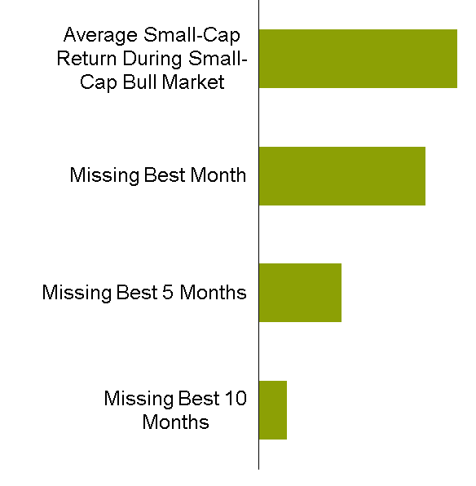
Small- and SMID-Cap Equities Remain Strategically Attractive
Average Annual Total Return During
Small-Cap Bull Markets**
Index Performance*
36.8%
Russell 2500
30.9%
Russell
2000
S&P500
15.2%
5.1%
Historical analysis and past performance do not guarantee future results.
*Through December 31, 2011
Individuals cannot invest directly in an index. Please see the end of the presentation for index definitions.
**As of September 30, 2011. Source of historical returns: CRSP®, Center for Research in Security Prices. Graduate School of Business, The University of Chicago, used with permission. All rights reserved. www.crsp.uchicago.edu. The performance has been calculated by BofA Merrill Lynch Small Cap Research. All rights reserved.
Source: BofA Merrill Lynch Small Cap Research, CRSP, Russell Investment Group, Standard & Poor’s and AllianceBernstein
Notes:
While we believe investors in this time of high volatility should be underweight strategic equity targets, equities still have an important role to play in portfolios. One continuing pocket of opportunity is in US small and mid-cap companies.
Over the past decade, small caps, represented here by the Russell 2000 index, and small and mid-caps (SMID), represented by the Russell 2500, have outperformed the S&P 500 index. Small and mid-cap stocks typically include growing, dynamic companies with the potential to create value for shareholders. Despite their outperformance over the past decade, as seen on the left, we believe this capitalization range still offers opportunity for investors.
We further believe that an allocation to small and mid-cap stocks should be strategic. History, as shown on the right, suggests that it is very difficult to “time” the performance of small and mid-cap stocks. Historically, small cap stocks have returned about 37% during small cap bull markets. Missing just one month of such markets would have detracted six percentage points. Missing the five best months would have detracted over twenty percentage points, and missing ten months would have detracted all but 5% of returns.
Small cap growth has outperformed value in 2011, but the result is that small and SMID-cap value stocks are selling at attractive valuations. For example, the S&P500 sells at price-to-sales of 1.2 times, while the SMID-cap Russell 2500 Value index sells at .9 times, a discount of 25% to the market.

Slide 17
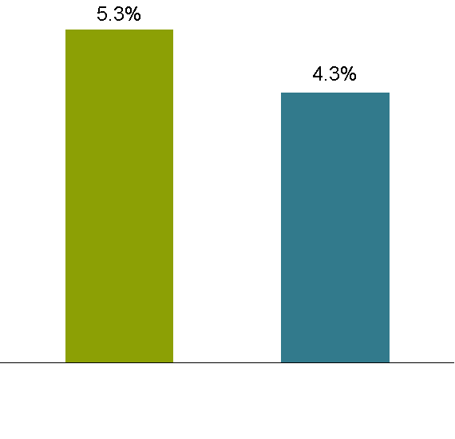
Equity Income: Yields Now Match Treasuries and Have Grown over Time
S&P 500 Dividend Yield vs. 10-Year US Treasury Yield*
Annual S&P 500 Dividend Growth vs. Inflation
1972–2010
S&P 500 Yield Greater
US Treasury Yield Greater
Dividend Growth Rate
Consumer Price Index
Current analysis and past performance do not guarantee future results.
*Through December 31, 2011
Source: Bloomberg, BLS, Standard & Poor’s, US Treasury and AllianceBernstein
Notes:
Another opportunity within equities is dividend paying stocks, stocks that pay you to wait for appreciation in equity prices.
This opportunity is particularly important today, because recently the dividend yield of the S&P 500 matches the ten year yield of US Treasuries. The only other time that’s happened in the last half century was as the market reached its bottom in late 2008/2009. While bonds don’t “grow” and can fall in value as interest rates rise, dividends often do grow, and their underlying equities represent ownership of growing companies. The display on the right shows that annual dividend growth of the S&P 500 over the last nearly four decades has exceeded inflation.

Slide 18
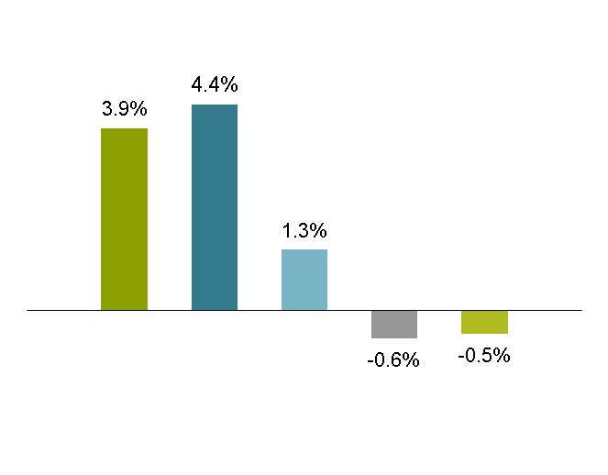
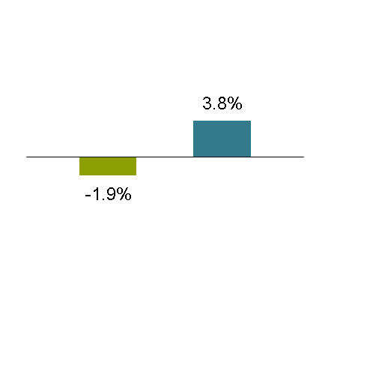
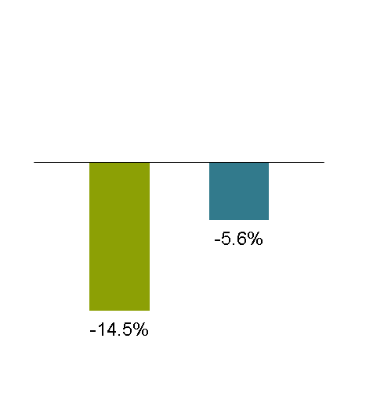
Why Not Simply Invest in the Highest-Yielding Stocks?
Highest Yield Doesn’t Necessarily Win
Highest Yield Is Not Most Resilient
Long-Term Excess Return by Dividend Yield Quintiles*
Down-Market Excess Return by Dividend Yield Quintiles
2007
2008
1st 2nd
1st 2nd
Annualized Excess Return
Annualized Excess Return
4th 5th
1st 2nd 3rd
Highest Yield
Lowest Yield
Current analysis and past performance do not guarantee future results.
*January 1978–November 2011; excludes non-dividend payers; annualized 36 month performance by quintile of dividend yield relative to the average return of the largest 1,500 US stocks.
Source: AllianceBernstein
Notes:
Building an optimal portfolio of dividend yield stocks is not as simple as it might at first appear. At times a high dividend yield merely reflects the depressed stock price of a troubled company that hasn’t cut its dividend yet. The fact is that the second quintile of dividend paying stocks has historically outperformed the first quintile.
What characterizes these top performers? Companies that return cash to shareholders typically outperform those that do not. Companies can return cash to shareholders in two ways: share repurchases and dividends. Bottom-up, stock-specific research can determine and forecast the sources and uses of cash, and interaction with management can lead to a better decision about how excess cash will be used. All of these factors should be considered when building equity income funds.
One of the additional benefits of building equity income portfolios based on cash flow rather than simple considerations of dividend yields is the resilience that comes with quality. In the crisis years of 2007 and 2008, the second quintile of dividend paying stocks held up better than the “top” quintile.
For investors who desire income and/or who are cautious about current equity market volatility, properly constructed equity income portfolios offer an attractive option.

Slide 19
Inflation Spikes Can Decimate Traditional Stock/Bond Portfolios
US Inflation and Negative 60/40 Real Returns
Rolling 10-Year Annualized
WWI Spike
WWII Spike
1970s Spike
Inflation
Deflation
Negative 10-Yr 60/40 Real Returns
Past performance does not guarantee future results. This is a hypothetical example and is not representative of any AllianceBernstein product. An investor cannot invest directly in an index or average and they do not include sales charges or operating expenses associated with an investment in a mutual fund, which would reduce total returns.
The portfolio comprises 60% stocks and 40% bonds; stocks are represented by the S&P 500 (with a Global Financial Data extension) and bonds by 10-year Treasuries. Inflation is measured by US CPI, US City Average, all items, not seasonally adjusted, through December 2010.
Source: Global Financial Data, US Bureau of Labor Statistics and AllianceBernstein
Notes:
The world is a highly unpredictable place. History is strewn with wars, crises, booms, and collapses, and there's no reason to expect that this pattern won't continue in the future.
Unpredictable events and circumstances can combine to create inflationary shocks. This display shows annual rates of inflation in the United States over the past 110 years, and includes the devastating deflation of the Great Depression and three major inflationary spikes. The blue bars show the 10-year rolling real returns of a 60/40 stock bond portfolio, which were negative during the three inflation shocks.
The implications of negative real returns are profound. For example, an investor who retired halfway through 1972 would have experienced an annualized inflation rate of 9% over the following decade...Assuming that retiree was spending 4% of his or her assets each year, fully 2/3 of their assets would have vanished by the middle of 1982.
Economists are notoriously poor at forecasting inflections in inflation, but we have strong reason to believe that inflationary pressures will reassert themselves in the years to come. The rapid growth of emerging market economies will demand vast amounts of commodities, increasing their price to the developed world, and the emergence of a middle class in emerging markets countries will add to the cost of goods we import. These powerful trends, combined with monetary policies seeking to manage high levels of debt in the developed world, are likely, in our view, to increase inflation risks.
There is no one silver bullet that offers protection from this risk, but our research has found that REITS, natural resource stocks, and commodity futures, dynamically managed based on market conditions, may offer significant inflation protection.

Slide 20
Dynamic Management Is Critical to Navigating Inflation Cycles
Average Annual Real Returns
High Growth/Low Inflation
Growth
High Growth/High Inflation
Inflation
Low Growth/Low Inflation
Low Growth/High Inflation
10.1%
5.0%
-6.3%
-7.8%
Real Estate
Commodities
Natural
Diversified
Stocks
Resource
Equities
Stocks
Historical analysis does not guarantee future results. Individuals cannot invest directly in an index. Diversification does not eliminate the risk of loss.
December 1972–June 2011
Data reflect averages of rolling one-year total returns measured quarterly. High (Low) Inflation represents periods where trailing one-year inflation rate was higher (lower) than its 1972–2011 average. High (Low) Growth represents periods where real GDP growth was higher (lower) than its 1972–2011 average.
Inflation is measured by US Consumer Price Index, US City Average, all items, not seasonally adjusted. Growth is represented by US Real Gross Domestic Product, seasonally adjusted. Real Estate Stocks represented by NAREIT US Equity REIT Index. Natural Resource Stocks represented by equally weighted Energy and Metals equity sector returns (rebalanced monthly) from Ken French Data Library through 1998 and by MSCI ACWI Commodity Producers Index thereafter. Commodities represented by S&P GSCI Commodity Index through 1991 and by DJ-UBS Commodity Index thereafter. Diversified Equities represented by MSCI World Index. Individuals cannot invest directly in an index. Please see the end of the presentation for index definitions.
Source: Bloomberg, Dow Jones, Ken French Data Library, MSCI, NAREIT, St. Louis Federal Reserve, Standard & Poor’s and AllianceBernstein
Notes:
As the four-quadrant table on this page indicates, the type of real asset that performs best at any point in time depends largely on the prevailing growth and inflation environment.
Leadership for real-asset categories changes over time as economic cycles evolve. To best capture opportunities and manage risks, we think an active approach that shifts allocations based on the prevailing environment can make a big difference.
For example, the bottom left quadrant highlights that in past environments of both low growth and low inflation, Real Estate Stocks and Natural Resource Stocks have provided the highest return potential, with commodities tending to lag behind even the broader stock market. Conversely, in the upper right quadrant (where we’ve seen high growth and high inflation), commodities have won the day, with Real Estate and Natural Resource Stocks performing similarly better than diversified equities.
The lesson: static strategies or strategies that are more heavily focused on one real asset are likely to do poorly over a long period of time compared with a strategy that’s actively managed from the top down. Dynamic management is critical to successfully navigating economic cycles over time both in terms of return and managing risk.
There’s another option investors might consider for further diversifying their equity exposure while providing some insulation against volatility…

Slide 21
High-Yield Corporate Bonds Historically Produce Equity-like Returns
Better Risk/Return Trade-off
Higher Yield, Higher Return Potential
Excess
Expected
Return
WorldCom/
Enron
Scenario
Spreads widen
another 100 b.p.
2.47%
+1 Std.
Dev.
7.0%
Spreads remain unchanged
Avg.
11.53%
Spreads narrow 100 b.p.
–1 Std.
Dev.
14.33%
Spreads narrow to
long-term average
Historical analysis and current estimates do not guarantee future results.
*Represented by the S&P 500
**Represented by the Barclays Capital US Corp. High Yield Index
Right chart: Spreads are option adjusted. Average and standard deviation are for January 1995 through September 30, 2011.
Expected return calculations are highly simplified and for illustrative purposes only. Assumptions: 12-month horizon; 4.53-year duration; change in spread (if any) occurs on last day of period.
Source: Barclays Capital, Standard & Poor’s and AllianceBernstein
Notes:
Thursday, January 12, 2012
20
In a volatile equity environment, high-yield bonds may be a suitable means of accessing returns that have historically been equity-like but with less volatility.
The display on the left shows the long term (since 1983) returns of equities (S&P500) and high yield bonds (the BarCap US Corp. High Yield). As you can see, those annualized returns have been roughly comparable, but with much less volatility.
We tested this relationship for the period 2007 to November 2011, and the pattern not only held but was superior. During this period of turbulence and risk aversion, equities have had negative returns, while high yield corporate have performed well, and although high yield volatility was higher than its long term average, it was still substantially less volatile than equities.
High-yield has also demonstrated a low correlation to other investment types. These attributes may argue for giving high yield its own seat at the asset-allocation table within the larger portfolio context—in this case, as a lower-volatility enhancement to investors’ remaining equity exposure.
The display on the right hand side shows that high yield bonds are still attractively priced.
Despite record corporate profits and strong cash flows, concerns over economic fundamentals have pushed high-yield spreads up to 7%. This extra yield compensates investors handsomely today for taking credit risk, and if the bad-news scenarios don’t unfold, spreads could decline, a boost to high-yield returns.
On the right, we’re showing some of the possible scenarios for high yield returns based on a variety of spread changes. If spreads continue to increase by another 1%, high yield bonds could outperform like-maturity Treasury bonds by 2.5%. If spreads remain where they are, excess returns would equal the spread. If spreads decline by 1%, excess returns could be more than 11%. And if spreads fall to their long-term averages, excess returns could be more than 14%.
Another consideration within high yield today is that the level of refinancing needs over the coming years has been greatly reduced. Refinancing has pushed back the so-called maturity wall that issuers faced, reducing the risk associated with these investments.

Slide 22
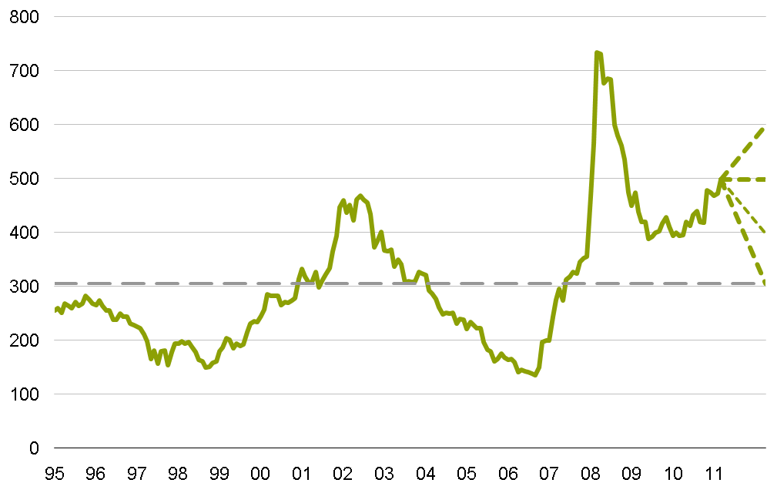
High-Yield Municipals Remain Inexpensive
Yield Advantage of Municipal High-Yield Debt
Relative to AAA Municipals (Basis Points)
Global Financial Crisis
1-Year
Excess
Return
vs. AAA
Scenario
WorldCom/
TMT Crisis
Underperformance
of Real Estate
Bonds
-3.5%
Spreads widen 100 b.p.
Post-9/11 Decline
in Airline Bonds
5.0%
Spreads remain unchanged
+1 Std. Dev.
13.5%
Spreads narrow 100 b.p.
Average
21.4%
Spreads narrow to long-term average
–1 Std. Dev.
Past performance and historical analysis do not guarantee future results.
Average and standard-deviation range are from 1995 through December 30, 2011. Spreads are to 10-yr AAA municipals.
Expected return calculations are highly simplified and for illustrative purposes only. Assumptions: 12-month horizon; 8.5-year duration; change in spread (if any) occurs on last day of period.
Source: Barclays Capital, Municipal Market Data Corp. and AllianceBernstein
Notes:
21
We think that high yield US municipals are similarly attractive. Fueled by unjustified concerns earlier this year, spreads on high yield munis rose from elevated levels.
The extra yield offered by high-yield municipal bonds compared to AAA-rated municipal bonds is nearly 5% today—much higher than its historical average of about 3%. Again, this provides attractive risk compensation for muni high-yield investors just for holding the bonds.
What could happen if yield spreads change? If spreads increase by 1%, high yield might underperform by nearly 4%, but if spreads decline by 1%, excess returns could be over 13%, and if they return to average levels, 19%. We believe that the potential for excess returns is skewed in favor of investors.

Slide 23
Municipals: Roll* Even More Valuable When Yield Curve Is Steep
AAA Municipal vs. Treasury Yield Curve
Differential Between One-Year and 20-Year Bonds
AAA Municipal Yields
Average
AAA Municipals
Treasury
“Roll” from AAA Municipals
Past performance and current analysis do not guarantee future results.
As of December 30, 2011
*Roll, or “rolling down the yield curve” refers to the expected price change of a bond as it ages; i.e. as its maturity shortens, its yield to maturity must fall/rise (and the bond’s price change accordingly) to reflect the respective shorter maturity’s yield.
Source: Municipal Market Data Corp. and AllianceBernstein estimates for AAA-rated, callable municipal bonds
Notes:
Thursday, January 12, 2012
22
We also think that AAA rated municipals offer attractive opportunities.
The first thing you notice when looking at the municipal bond market today is the level of yields relative to taxable bond yields. Typically, municipal bond yields are lower than those of equal maturity Treasury bonds due to the tax advantages of municipal bond income. Today, though, many municipal bond yields are higher than those of Treasury bonds—even before factoring in the tax-exemption of muni income. That alone makes munis a compelling proposition. The ability to enhance muni returns by actively rolling down the yield curve adds to potential returns. The upper right-hand chart shows that the AAA muni yield curve is steeper than average – meaning more opportunity for active managers – and the lower right hand chart shows that roll opportunities are greatest in the intermediate maturities.

Slide 24
States Can Pay Their Debts
Strategies Used by States to
Reduce Budget Gaps Fiscal 2011
States Are Not Drowning in Debt Like Greece
Government Debt Outstanding
as a Percent of GDP or GSP**
Number of States
*Includes user fees, higher education-related fees, court-related fees, transportation/motor vehicle-related fees and business-related fees.
**Gross State Product is represented by personal income.
***Greece data for 2010 from CIA World Fact Book. State data from Moody’s as of May 2011.
Source: Bureau of Economic Analysis, Eurostat, The Fiscal Survey of States, Fall 2010 and Spring 2011, state financial reports; Hellenic Republic Ministry of Economy and Finance, National Association of State Budget Officers, National Governors Association and AllianceBernstein
23
23
Notes:
The mispricing of municipals today is due in part to concerns about levels of state and local government debt and deficits. While there have been some notable (and predictable) defaults, we believe these fears are overblown.
First, 49 out of 50 states are required to balance their budgets (Vermont is the exception). When state tax receipts fell during the recession, budgets were put under pressure. States acted aggressively, and the display on the left shows the number of states that took particular actions. As the economy has recovered, state tax receipts are recovering.
The numbers one often hears associated with state debt sometimes includes the present value of unfunded pension obligations. These are obligations that are to be paid over many decades, and their stated value today is inflated by very low interest rates that drive down the discount rate (and increase the present value). States are also working through these issues by moving to defined contribution plans and changing benefits.
What is clear to us is that the fears surrounding levels of sovereign debt in the Euro Area are of an entirely different magnitude than those faced by the US states. Leaving aside revenue bonds, which are financed from proceeds of the projects they fund, the general obligations of states like California and New York are only about 6% of their Gross State Product (a state version of GDP). Greece, by contrast, has debt of over 140% of its GDP.
As the fiscal obligations of states are better understood in the marketplace and economic conditions improve, the credit risk priced into municipals today should lead to attractive returns.

Slide 25
High-Grade Bond Strategies: Exploit Roll and Global Opportunities
Yield Curves Are Extremely Steep
Country Returns Vary Significantly Across Cycles
Developed-Market Yields
Percent
Fixed-Income Country Returns Percent (USD Hedged*)
2006
2007
2008
2009
2009
2010
2011
Best
Japan
5.3
US
Treasuries
9.0
Australia
15.1
Euro Area
4.1
UK
7.2
UK
15.8
Canada
4.6
Japan
7.8
US
Treasuries
13.7
Japan
1.4
US
Treasuries
5.9
US
Treasuries
9.6
US
Treasuries
3.1
Canada
5.7
Canada
11.7
UK
–1.6
Canada
5.6
Australia
8.4
Euro Area
1.8
UK
4.7
UK
10.4
Canada
–1.9
Japan
2.9
Canada
8.2
Australia
1.2
Euro Area
3.1
Euro Area
8.4
US
Treasuries
–3.6
Euro Area
1.0
Euro Area
2.6
UK
0.9
Australia
2.0
Japan
6.7
Australia
–5.9
Australia
0.3
Japan
2.5
Worst
Gap between
best and worst
4.4
7.0
8.4
10.0
6.9
13.3
Past performance and current analysis do not guarantee future results.
As of December 28, 2011
*These returns are for illustrative purposes only and do not reflect the performance of any fund. Diversification does not eliminate the risk of loss. Returns represented by respective Barclays Capital country bond indices. An investor cannot invest directly in an index or average and they do not include sales charges or operating expenses associated with an investment in a mutual fund, which would reduce total returns.
Source: Barclays Capital, Bloomberg, Haver Analytics, National Accounts, US Department of the Treasury and AllianceBernstein
Notes:
24
At the outset, we noted the strong relative returns of high-grade sovereign bonds in 2011, but as a result, of course, available yields heading into 2012 are near record lows. This raises the question – again – of the value of holding high-quality bonds, however, it is important to continue to remember the important benefits that high-quality bonds bring to a well-designed portfolio; namely, to act as a source of stability (to counter volatility) and diversification.
Also, as with municipals, in the left-hand display you can see that short-term yields are much lower than longer maturity yields. This gives the yield curve chart a steep upward slope as maturities grow longer, and one can take advantage of this extreme relationship by “rolling down the yield curve.”
As intermediate-term bonds age, they gradually become shorter-term bonds that pay higher income than other short-term bonds. Imagine how valuable a five-year US Treasury bond paying income of 1.8% would be as it ages and becomes a four-year bond and then a three-year bond, where yields might be 1% or less. This makes the bond more attractive and its value typically rises because of it. Actively managing this “roll” may enhance returns.
Secondly, a critical message is that globalizing a bond portfolio allows you to reduce its direct sensitivity to home-market interest rates. Historically, this has been effective because economic cycles aren’t synchronized across countries, countries that change interest rates at different times depending on their particular circumstances. In today’s environment of challenged government balance sheets, the benefit of country diversification is even greater.
Lastly, return differences between countries can be significant. The display on the right shows the currency-hedged returns of six large, developed, liquid bond markets by calendar year. These markets trade leadership each year, and the differences between the best and worst performances can be quite substantial, creating an opportunity for active bond managers to exploit.

Slide 26
Currency Remains Volatile
US Dollar Has Weakened over the Past Decade
Currency Volatility Overwhelms Bond Volatility
US Dollar vs. Basket of Developed Currencies*
Historic Volatility**
The US Dollar May Have Reached An Inflection Point
Currency Volatility Remains Elevated
Currency
Index
Percent
Currency-Hedged Global Bonds
Historical analysis does not guarantee future results.
*Purchasing Power Parity–weighted returns
**Historic volatility of developed currencies and historic volatility of the Barclays Capital Global Aggregate hedged to US dollars
Through November 30, 2011
Source: Barclays Capital, JPMorgan and AllianceBernstein
Notes:
We mentioned that the previous display showed hedged bond returns, and we believe this is important. Currency can have profound impacts on both returns and volatilities of global portfolios, and one should be mindful of the significant difference between bond and currency behavior.
The display on the left shows the movement of the US dollar versus a basket of international developed currencies. You can see that exchange rate movements can be large, and they are strongly auto correlated, meaning that they tend to move in one direction for extended periods of time. We are at the end of a decade-long period of USD weakening and may have reached an inflection point that may lead to a period of USD strengthening versus developed currencies. In a period of a declining dollar, unhedged investors in overseas bonds benefitted from local returns being converted into weaker US dollars, but if the US dollar starts to strengthen over time, unhedged foreign currency exposure would turn into a detractor.
The display on the right shows historic developed country currency volatility. Currency volatility, which is ordinarily much higher than bond volatility, spiked in 2008 and remains highly elevated. Not shown, emerging markets currencies have been even more volatile. Comparing this to hedged global bond volatility, it’s clear that currency volatility can overwhelm underlying bond volatility. This is a critical consideration in fixed income portfolio construction, which is why we strongly advise hedging global bond holdings within a core allocation.
Said another way: Do you really want to port that kind of volatility onto the part of your portfolio that’s supposed to be providing stability?

Slide 27
The Big Picture
Stocks attractive based on long-term valuations, but volatility detracts in near term
We expect the global economic recovery to continue despite near-term risks, including potential policy errors and recent recession in Europe
Today’s markets present attractive investment opportunities:
  While our view is that equities should be underweight strategic targets, equity income and small/SMID cap strategies are promising
  Real-asset and high-yield strategies today offer equity-like return potential with low correlation
  Municipals are attractive relative to taxable bonds
  High-grade bonds should be managed globally and to exploit roll
Diversification does not eliminate the risk of loss.
As of December 29, 2011
Notes:
We’ve covered a wide range of topics relating to our view of the capital markets today, so let’s summarize:
- Stocks attractive based on long-term valuations, but volatility detracts in near term
- We expect the global economic recovery to continue despite near-term risks, including potential policy errors and recent recession in Europe
- Today’s markets present attractive investment opportunities:
While our view is that equities should be underweight strategic targets, equity income and small/SMID cap strategies are promising
Real asset and high-yield strategies today offer equity-like return potential with low correlation
Municipals are attractive relative to taxable bonds
High-grade bonds should be managed globally and to exploit roll
Thank you. I’d be happy to take your questions now.

Slide 28
Index Descriptions
Following are descriptions of the indices referred to in this presentation. It is important to recognize that all indices are unmanaged and do not reflect fees and expenses associated with the active management of a mutual fund portfolio. Investors cannot invest directly in an index, and its performance does not reflect the performance of any AllianceBernstein mutual fund.
Standard & Poor’s Index (S&P 500) Widely regarded as the best single gauge of the US equities market, this world-renowned index includes a representative sample of 500 leading companies in leading industries of the US economy. Although the S&P 500 focuses on the large-cap segment of the market, with more than 80% coverage of US equities, it is also an ideal proxy for the total market. The S&P 500 is part of a series of US indices that can be used as building blocks for portfolio construction. With close to $1 trillion in indexed assets, the S&P US indices have earned a reputation of being not only leading market indicators, but also investable portfolios designed for cost-efficient replication or the creation of index-linked products. (represents US Large Cap on slide 1)
The S&P GSCI (formerly the Goldman Sachs Commodity Index) serves as a benchmark for investment in the commodity markets and as a measure of commodity performance over time.
Morgan Stanley Capital International (MSCI) World Index is a market capitalization–weighted index that measures the performance of stock markets in 24 countries.
MSCI ACWI Index is a free float–adjusted market capitalization–weighted index designed to measure the equity market performance of developed and emerging markets. The MSCI ACWI consists of 45 country indices comprising 24 developed and 21 emerging market country indices.
MSCI EAFE Index (Europe, Australasia, Far East) is a free float–adjusted market capitalization index that is designed to measure developed market equity performance, excluding the US and Canada. As of April 2002, the MSCI EAFE Index consisted of the following 22 developed market country indices: Australia, Austria, Belgium, Denmark, Finland, France, Germany, Greece, Hong Kong, Ireland, Israel, Italy, Japan, the Netherlands, New Zealand, Norway, Portugal, Singapore, Spain, Sweden, Switzerland and the United Kingdom.
MSCI Emerging Market Index is a free float–adjusted market capitalization index designed to measure equity market performance in the global emerging markets. It consists of 21 emerging market country indices. (represents EM on slide 1)
MSCI USA Index is a free float–adjusted market capitalization index designed to measure large- and mid-cap US equity market performance. The MSCI USA Index is member of the MSCI Global Equity Indices and represents the US equity portion of the global benchmark MSCI ACWI Index.
MSCI Commodity Producers Index is free float–adjusted market capitalization–weighted index comprised of commodity producer companies based on the Global Industry Classification Standard (GICS®).
Barclays Capital Global Emerging Markets Index represents the union of the USD-denominated U.S. Emerging Markets Index and the predominately EUR-denominated Pan Euro Emerging Markets Index, covering emerging markets in the following regions: Americas, Europe, Middle East, Africa, and Asia. As with other fixed income benchmarks provided by Barclays Capital, the index is rules-based, which allows for an unbiased view of the marketplace and easy replicability. (represents EM Debt on slide 1)
Notes:
Thursday, January 12, 2012
27
READ TO AUDIENCE

Slide 29
Index Descriptions (continued)
Barclays Capital Global Aggregate–Corporate Bond Index tracks the performance of investment-grade corporate bonds publicly issued in the global market found in the Global Aggregate. (represents Global Corp on slide 1)
Barclays Capital Global High-Yield Index provides a broad-based measure of the global high-yield fixed-income markets. The Global High-Yield Index represents the union of the US High-Yield, Pan-European High-Yield, US Emerging Markets High-Yield, CMBS High-Yield and Pan-European Emerging Markets High-Yield Indices. (represents Global High Yield on slide 1)
Barclays Capital Municipal Bond Index is a rules-based, market-value-weighted index engineered for the long-term tax-exempt bond market. (represents Municipals on slide 1)
Barclays Capital US Corporate High Yield Index–2% Issuer Capped Bond Index covers the USD-denominated, non-investment-grade, fixed-rate taxable corporate bonds that are classified as high yield in the middle rating of Moody’s, Fitch and S&P is Ba1/BB+/BB+ or below. Excludes Emerging Markets. Caps issuers at 2%.
Barclays Capital US Treasury–US TIPs Index consists of Inflation-Protection securities issued by the US Treasury. (represents TIPS on slide 1)
Barclays Capital US Treasury Index includes fixed-rate, local currency sovereign debt that make up the US Treasury sector of the Global Aggregate Index. (represents US Gov’t on slide 1)
Barclays Capital Japan Treasury Index includes fixed-rate, local currency sovereign debt that make up the Japanese Treasury sector of the Global Aggregate Index. (represents Japan Gov’t on slide 1)
Barclays Capital Euro Treasury Index includes fixed-rate, local currency sovereign debt that make up the Euro Treasury sector of the Global Aggregate Index. (represents Euro Gov’t on slide 1)
Barclays Capital Canada Treasury Index includes fixed-rate, local currency sovereign debt that make up the Canadian Treasury sector of the Global Aggregate Index.
Barclays Capital Euro Area Treasury Index includes fixed-rate, local currency sovereign debt that make up the Euro Area Treasury sector of the Global Aggregate Index.
Notes:
Thursday, January 12, 2012
28
READ TO AUDIENCE

Slide 30
Index Descriptions (continued)
Barclays Capital United Kingdom Treasury Index includes fixed-rate, local currency sovereign debt that make up the United Kingdom Treasury sector of the Global Aggregate Index.
Barclays Capital Australia Treasury Index includes fixed-rate, local currency sovereign debt that make up the Australian Treasury sector of the Global Aggregate Index.
DJ-UBS Total Return Commodity Index is an index consisting of exchange-traded futures on 19 physical commodities that are weighted to account for economic significance and market liquidity. (represents Commodities on slide 1)
FTSE EPRA/NAREIT Global Real Estate Index is designed to represent general trends in eligible real estate equities worldwide. (represents Global REITS on slide 1)
FTSE NAREIT US Equity Reit Index is designed to represent general trends in eligible real estate equities in the US.
Russell 2000 Index measures the performance of the small-cap segment of the US equity universe. It is a subset of the Russell 3000® Index representing approximately 8% of the total market capitalization of that index. It includes approximately 2,000 of the smallest securities based on a combination of their market cap and current index membership. (represents US Small Cap on slide 1)
Russell 2500 Index measures the performance of the small- to mid-cap segment of the U.S. equity universe, commonly referred to as "smid" cap. The Russell 2500 is a subset of the Russell 3000® Index. It includes approximately 2,500 of the smallest securities based on a combination of their market cap and current index membership.
Notes:
Thursday, January 12, 2012
29
READ TO AUDIENCE

Slide 31

AllianceBernstein ® and the AB logo are registered trademarks and service marks used by permission of the owner, AllianceBernstein L.P.
©2012 AllianceBernstein L.P.
www.alliancebernstein.com
12-0039
Notes:
Thursday, January 12, 2012
30

